Slide 1
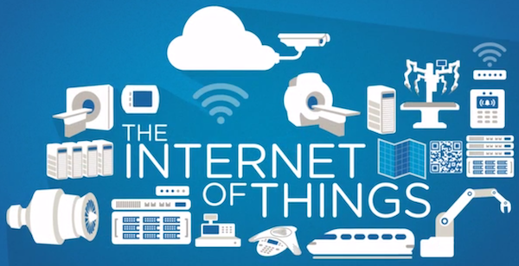

Slide 2
Sources Used
Internet of things: Vision, applications and research challenges [ Daniele Miorandi a, Sabrina Sicari b, Francesco De Pellegrini a, Imrich Chlamtac a ]
Internet of Things (IoT): A vision, architectural elements, and future directions [ Jayavardhana Gubbia, Rajkumar B, Slaven M, Marimuthu Palaniswami ]
Standardized Protocol Stack for the Internet of (Important) Things [ Maria R P, Nicola A, Xavier V, Thomas Watteyne, Luigi Alfredo G, Gennaro Band Mischa D]
A Routing Protocol for Internet of Things with High-speed Mobile Nodes [Hua-Mei Xin , Kun Yang ]
Smart Objects as Building Blocks for the Internet of Things [ Frédér ic Thies se , Florian Michahel les ]
Research on the Architecture and Key Technology of Internet of Things (loT) Applied on Smart Grid [Miao Yun, Bu Yuxin]
How the Next Evolution of the Internet Is Changing Everything [Davie Evans]
Internet of Things – A Paradigm Shift of Future Internet Applications [Sarita Agrawal, Manik Lal Das]
From Today’s Intranet Of Things To A Future Internet Of Things: A Wireless - And Mobility-Related View [Michele Zorzi, Alexander Gluhak, Sebastian Lange, Alessandro Bassi ]
From RFID To The Internet of Things [ John Buckley ]

Slide 3
Internet of Things
Interconnection of physical objects with Internet by means of extended Internet Technologies.
IoT is enabled through ‘Smart Objects’ by embedding electronics into them.
It is mapping of physical world with virtual world for analyzing, sensing, actuation, monitoring systems.

Slide 4
Requirements
IoT requires the smart objects to be
Identifiable
Communicative
Interactive

Slide 5
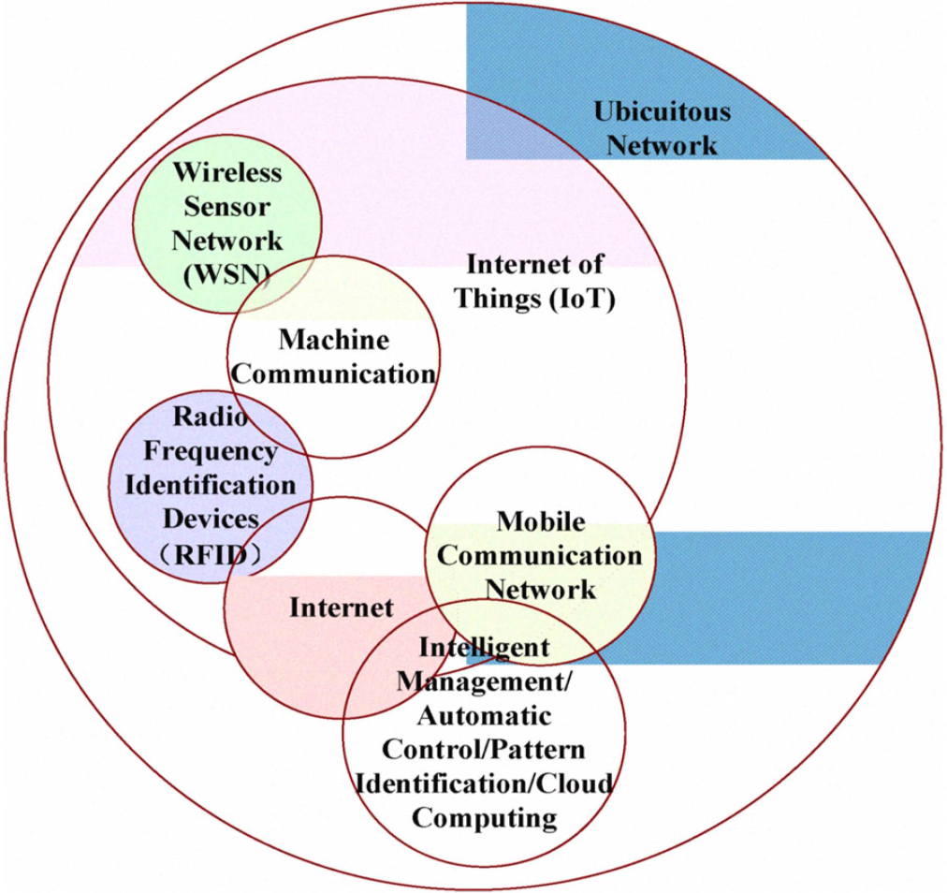
Major Technologies Involved in IoT Infrastructure
RFID
Wireless Sensor Networks
Mobile Networks
Cloud Computing

Slide 6
Radio Frequency Identification (RFID)
It helps in automatic identification of any thing they are attached with.
Components:
RFID Tags
RFID Readers
Base Station
Limitations:
Placement of tags and sensors are not so easy
Security and Privacy issues

Slide 7
Wireless Sensor Network (WSN)
It consist of a large number of tiny sensor nodes capable of sensing the objects and environment.
Limitations:
Random topology
Battery constraints
Security Issue

Slide 8
Mobile Communications Technology
Effectively shifting the wireless communication from voice-centric to data centric.
Dominating mobile technologies
Global System for Mobile Communications
Code Division Multiple Access
3G and 4G
Limitations:
Insufficient bandwidth
Transmission interference

Slide 9
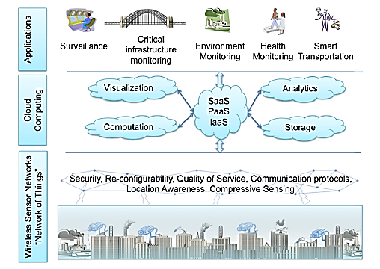
Cloud Computing
It is the combine framework with the various clouds at center
Limitations:
Possible downtime
Security and Privacy

Slide 10
Research Challenges
Heterogeneity of Devices
Scalability
Naming, Addressing and Identification
Location and tracking capabilities
Traffic and Congestion management
Security and Privacy
Energy optimization
Semantic interoperability and data management

Slide 11
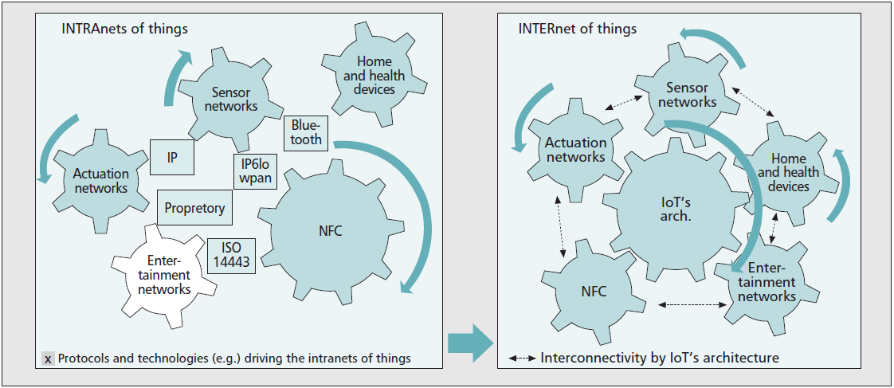
From the current “Intranets of Things” to the “Internet of Things.”

Slide 12
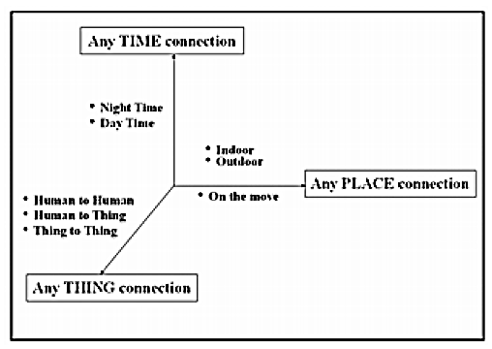
Why IoT is important?
AAA (AnyTime-AnyThing-AnyPlace)

Slide 13
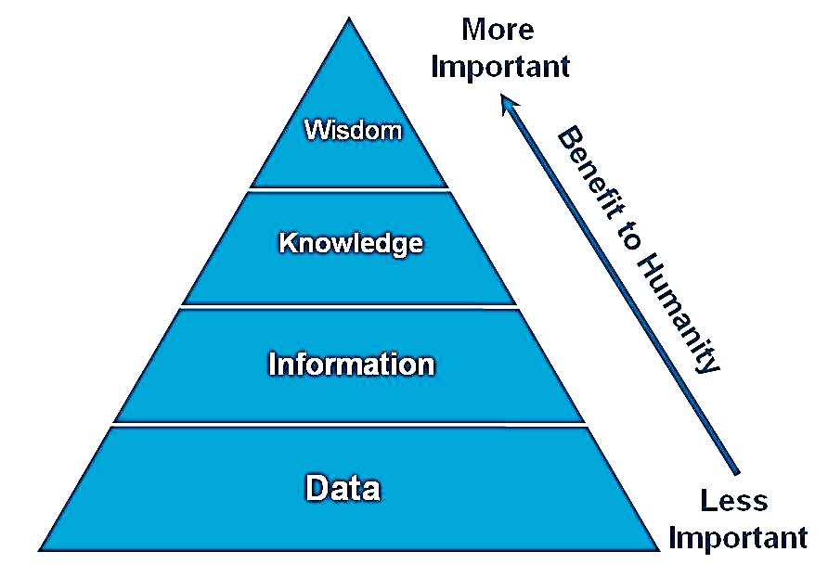
We evolve because we communicate
It’s the real evolution of Internet
Allowing us to become more proactive and less active

Slide 14
Applications
Society
Smart City
Health Care
Smart Home
Border Security and Military Application
Industry
Smart Business
Supply Chain
Agriculture and Rural Development
Environment
Climate Monitoring
Natural Calamities

Slide 15
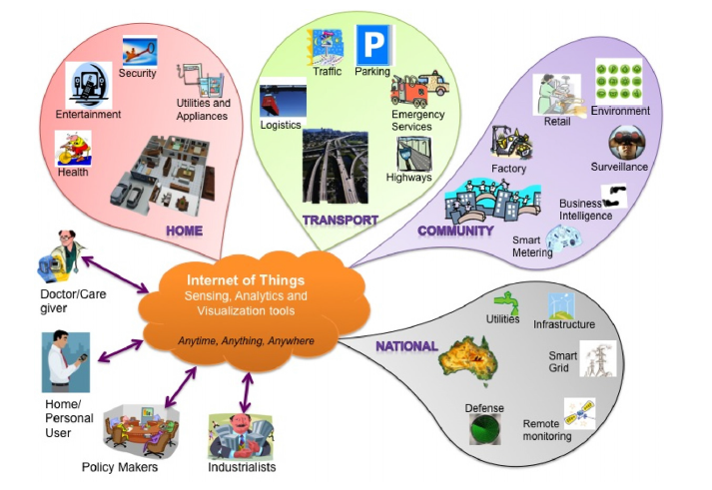

Slide 16
Architecture of IOT
It can be divided into three layers:
Perception layer
Network layer
Application layer

Slide 17
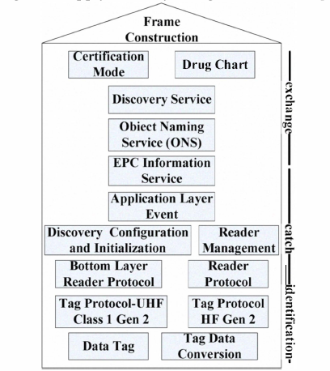
EPC global standard structure

Slide 18
Routing Protocol for IoT
Reverse Energy Ad-hoc On Demand Distance vector routing protocol (REAODV) is used with high speed mobile nodes.
It is based on traditional AODV routing protocol.

Slide 19
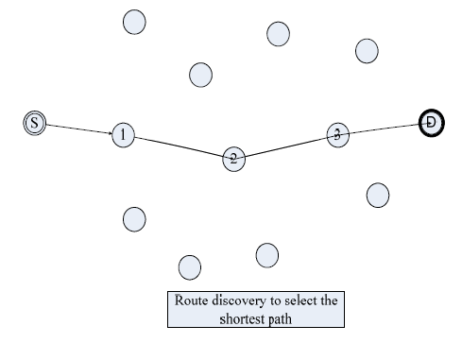

Slide 20
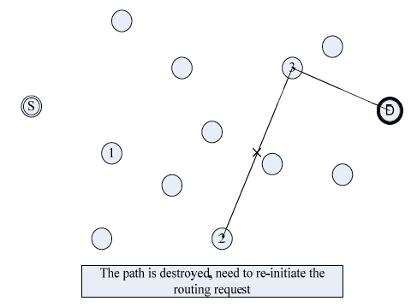

Slide 21
Standardized Protocol Stack
Motivation
low power consumption is required.
Existing Internet Protocols not optimized for such communication.
Core Requirements
Low power communication stack
Highly reliable communication stack
Internet enabled communication stack

Slide 22
Standards and Protocols Involved
Physical Layer
IEEE 802.15.4 defines a low power physical layer.
enables transmission while keeping the radio off most of the time.
Data Link Layer
IEEE 802.15.4e working group.
Uses Time Synchronized multiple hopping protocol.

Slide 23
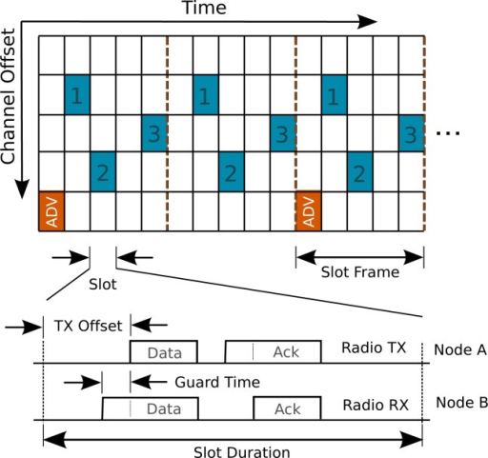

Slide 24
Network Layer
IETF 6LoWPAN
6LoWPAN was shaped for transmitting IPV6 over IEEE 802.15.4 networks.
Works as a sub adaptation layer
Issues addressed:
Mismatch in size.
Header overhead.
Works by compressing the header.

Slide 25
Network Layer (Continued)
Routing
RPL proposed by IETF ROLL group.
quickly able to build up network routes.
Mechanism:
Nodes are connected through multi hop paths to a small set of root devices.
For each of them a DODAG is constructed.

Slide 26
Transport Layer and Above
enable systems to interoperability.
Transport over LLNs:
Use of caching.
Selective Repeat variant.
Use of UDP where possible.
Application layer:
Issue here is the vast range of devices involved.
IETF has defined Constrained Application Protocol(CoAP).

Slide 27
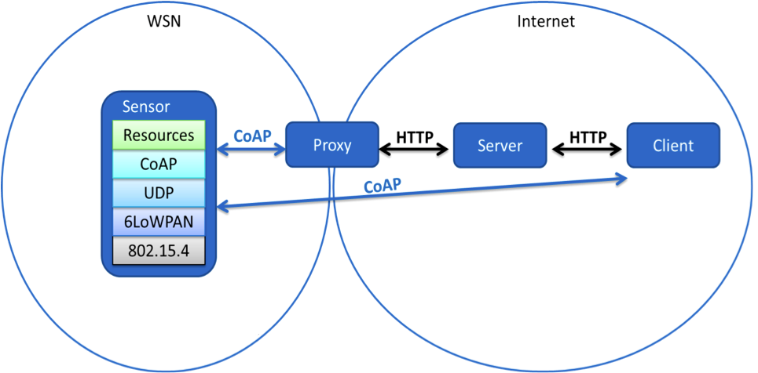
CoAP (Continued)
CoAP easily translates to HTTP for integration with the web.

Slide 28
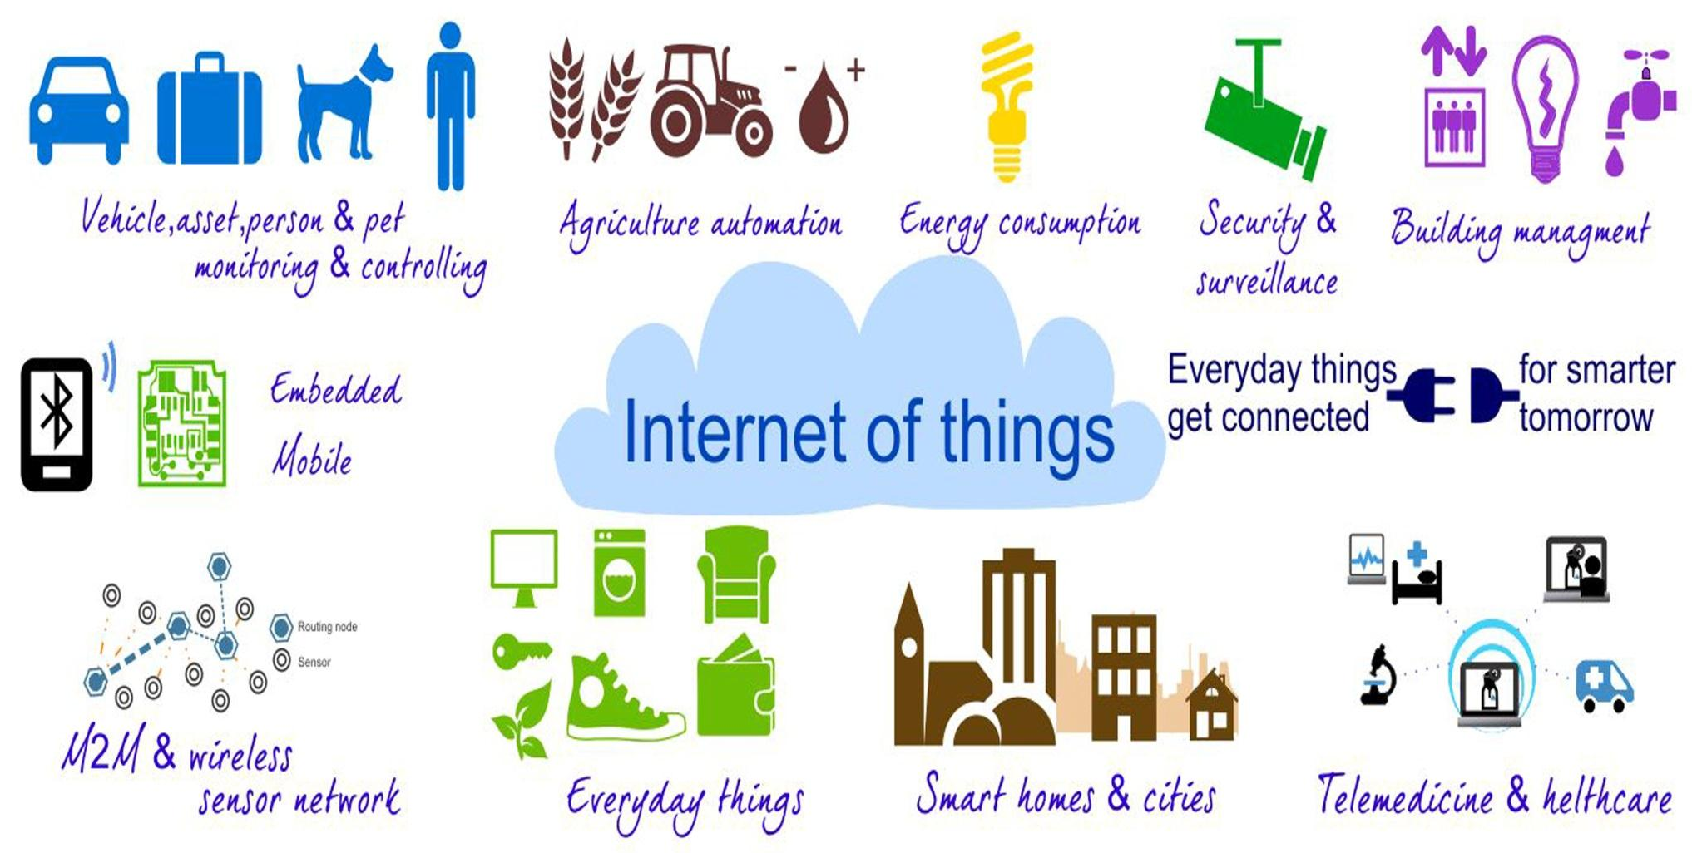
Questions?

Slide 29
Thank You
Submitted By:
Harpreet Kaur 14535018
Nikita Jain 14535031
Nimita Mangal 14535022
Nishtha Behal 14535032

